Slide 1
MPC II
MR. D.O. MURABULA

Slide 2
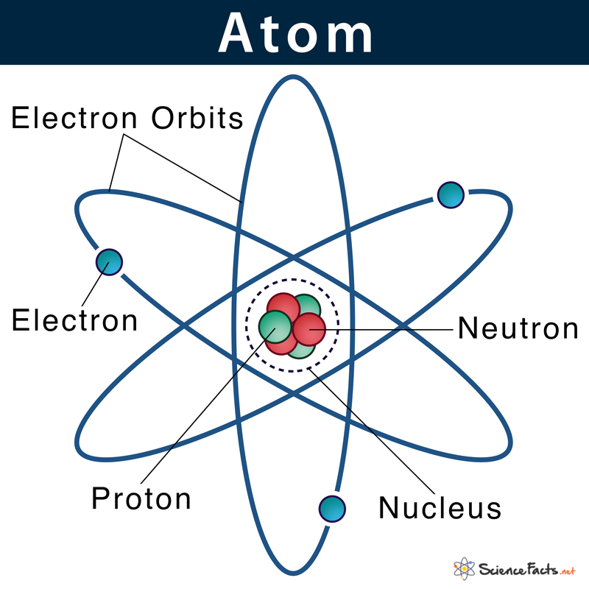

Slide 3
ATOM
The atom can be viewed as a miniature solar system whose sun is the nucleus and whose planets are the electrons.
The arrangement of electrons around the nucleus determines the manner in which atoms interact.
Nuclear structure is now well defined: Nucleons (protons and neutrons) are composed of quarks that are held together by gluons.
Only the three primary constituents of an atom, the electron, the proton, and the neutron, are considered here, they are the fundamental particle

Slide 4
Because an atomic particle is extremely small, its mass is expressed in atomic mass units (amu) for convenience.
One atomic mass unit is equal to one twelfth the mass of a carbon-12 atom.
The electron mass is 0.000549 amu.
When precision is not necessary, a system of whole numbers called atomic mass numbers is used.
The nucleus contains particles called nucleons.
There are two types of particles: protons and neutrons.

Slide 5
Both particles have nearly 2000 times the mass of an electron.
The mass of a proton is 1.673 × 10−27 kg; the neutron is just slightly heavier at 1.675 × 10−27 kg.
The atomic mass number of each is one.
The primary difference between a proton and a neutron is electric charge.
The proton carries one unit of positive electric charge.
The neutron carries no charge; it is electrically neutral.
Possible electron orbits are grouped into different “shells.”
The arrangement of these shells helps reveal how an atom reacts chemically, that is, how it combines with other atoms to form molecules.

Slide 6
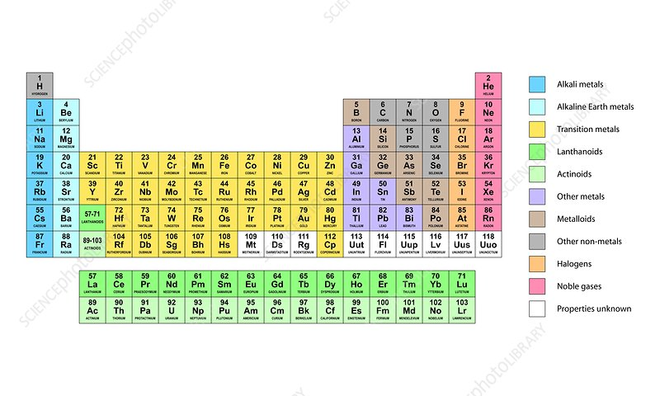

Slide 7
Because a neutral atom has the same number of electrons in orbit as protons in the nucleus, the number of protons ultimately determines the chemical behavior of an atom.
The number of protons determines the chemical element.
Atoms that have the same number of protons but differ in the number of neutrons are isotopes; they behave in the same way during chemical reactions.

Slide 8
The periodic table of the elements lists matter in order of increasing complexity, beginning with hydrogen (H).
An atom of hydrogen contains one proton in its nucleus and one electron outside the nucleus.
Helium (He), the second atom in the table, contains two protons, two neutrons, and two electrons.
The third atom, lithium (Li), contains three protons, four neutrons, and three electrons

Slide 9
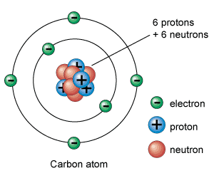

Slide 10
The Structure of Matter in which electrons are in the same orbital shell, the K shell, as are the electrons of hydrogen and helium.
The third electron is in the next farther orbital shell from the nucleus, the L shell.
Electrons can exist only in certain shells, which represent different electron binding energies or energy levels.
For identification purposes, electron orbital shells are given the codes K, L, M, N, and so forth, to represent the relative binding energies of electrons from closest to the nucleus to farthest from the nucleus.
The closer an electron to the nucleus, the greater its binding energy.

Slide 11
The next atom on the periodic table, beryllium (Be), has four protons and five neutrons in the nucleus.
Two electrons are in the K shell, and two are in the L shell.
The complexity of the electron configuration of atoms increases as one progresses through the periodic table to the most complex naturally occurring element, uranium (U).

Slide 12
Uranium has 92 protons and 146 neutrons.
The electron distribution is as follows:
2 in the K shell, 8 in the L shell, 18 in the M shell, 32 in the N shell, 21 in the O shell,9 in the P shell, 2 in the Q shell.
The total number of electrons in the orbital shells is exactly equal to the number of protons in the nucleus.
If an atom has an extra electron or has had an electron removed, it is said to be ionized.

Slide 13
An ionized atom is not electrically neutral but carries a charge equal in magnitude to the difference between the numbers of electrons and protons.
Atoms, however, cannot be ionized by the addition or subtraction of protons because they are bound very strongly together, and that action would change the type of atom.
An alteration in the number of neutrons does not ionize an atom because the neutron is electrically neutral.
The x-ray transfers its energy to an orbital electron and ejects that electron from the atom.

Slide 14
This process requires approximately 34 eV of energy.
The x-ray may cease to exist, and an ion pair is formed.
The remaining atom is now a positive ion because it contains one more positive charge than negative charge.
Ionization is the removal or addition of an orbital electron from an atom.
In all except the lightest atoms, the number of neutrons is always greater than the number of protons.
The larger the atom, the greater the abundance of neutrons over protons.

Slide 15
The maximum number of electrons that can exist in each shell increases with the distance of the shell from the nucleus.
Electron limit per shell can be calculated from the expression:
Even the largest atom does not completely fill shell O or higher.
Physicists call the shell number n the principal quantum number.
Every electron in every atom can be precisely identified by four quantum numbers, the most important of which is the principal quantum number.
The other three quantum numbers represent the existence of subshells, which are not important to radiologic science.

Slide 16
Relationship between the number of shells in an atom and its position in the periodic table of the elements.
Oxygen has eight electrons; two occupy the K shell, and six occupy the L shell.
Oxygen is in the second period (row) and the sixth group (column) of the periodic table.
Aluminum has the following electron configuration: K shell, two electrons; L shell, eight electrons; M shell, three electrons.
Therefore, aluminum is in the third period (M shell) and third group (three electrons) of the periodic table.

Slide 17
All atoms that have one electron in the outer shell lie in group I of the periodic table; atoms with two electrons in the outer shell fall in group II, and so forth.
When eight electrons are in the outer shell, the shell is filled.
Atoms with filled outer shells lie in group VIII, the noble gases, and are very chemically stable.
The orderly scheme of atomic progression from smallest to largest atom.
Instead of simply adding electrons to the next outer shell, electrons are added to an inner shell.

Slide 18
The atoms associated with this phenomenon are called the transitional elements.
Even in these elements, no outer shell ever contains more than eight electrons.
The chemical properties of the transitional elements depend on the number of electrons in the two outermost shells.
You might expect that an electron would spontaneously fly off from the nucleus, just as a ball twirling on the end of a string would do if the string were cut.
The type of force that prevents this from happening is called centripetal force or “center-seeking” force, which results from a basic law of electricity that states that opposite charges attract one another and like charges repel.

Slide 19
Electrons revolve about the nucleus in fixed orbits or shells.
Electrostatic attraction results in a specific electron path about the nucleus.
Centripetal force Resulting motion Velocity .
The force that keeps an electron in orbit is the centripetal force.
In the normal atom, the centripetal force just balances the force created by the electron velocity, the centrifugal force or flying-out-from-the-center force, so that electrons maintain their distance from the nucleus while traveling in a circular or elliptical path.
Representation of this state of affairs for a small atom.
In more complex atoms, the same balance of force exists and each electron can be considered separately.

Slide 20
Electron Binding Energy
The strength of attachment of an electron to the nucleus is called the electron binding energy, designated Eb.
The closer an electron to the nucleus, the more tightly it is bound.
K-shell electrons have higher binding energies than L-shell electrons, L-shell electrons are more tightly bound to the nucleus than M-shell electrons, and so forth.
Not all K-shell electrons of all atoms are bound with the same binding energy.

Slide 21
The greater the total number of electrons in an atom, the more tightly each is bound.
To put it differently, the larger and more complex the atom, the higher is the Eb for electrons in any given shell.
Because electrons of atoms with many protons are more tightly bound to the nucleus than those of small atoms, it generally takes more energy to ionize a large atom than a small atom.
Binding energy of electrons of several atoms of radiologic importance.
The metals tungsten (W) and molybdenum (Mo) are used as targets in an x-ray tube. Barium (Ba) and iodine (I) are used.

Slide 22
Electron Arrangement
The maximum number of electrons that can exist in each shell increases with the distance of the shell from the nucleus.
These numbers need not be memorized because the electron limit per shell can be calculated from the expression:
Maximum Electrons Per Shell 2n2 where n is the shell number.
This answer, 50 electrons, is a theoretical value.
Oxygen has eight electrons; two occupy the K shell, and six occupy the L shell.
Oxygen is in the second period (row) and the sixth group (column) of the periodic table.

Slide 23
Aluminum has the following electron configuration: K shell, two electrons; L shell, eight electrons; M shell, three electrons.
Therefore, aluminum is in the third period (M shell) and third group (three electrons) of the periodic table.
The orderly scheme of atomic progression from smallest to largest atom.
Instead of simply adding electrons to the next outer shell, electrons are added to an inner shell.
The atoms associated with this phenomenon are called the transitional elements.

Slide 24
All atoms that have one electron in the outer shell lie in group I of the periodic table; atoms with two electrons in the outer shell fall in group II, and so forth.
When eight electrons are in the outer shell, the shell is filled. Atoms with filled outer shells lie in group VIII, the noble gases, and are very chemically stable.
Instead of simply adding electrons to the next outer shell, electrons are added to an inner shell.
The atoms associated with this phenomenon are called the transitional elements.
Even in these elements, no outer shell ever contains more than eight electrons.

Slide 25
The chemical properties of the transitional elements depend on the number of electrons in the two outermost shells.
The shell notation of the electron arrangement of an atom not only identifies the relative distance of an electron from the nucleus but also indicates the relative energy by which the electron is attached to the nucleus.
The type of force that prevents this from happening is called centripetal force or “center-seeking” force, which results from a basic law of electricity that states that opposite charges attract one another and like charges repel.

Slide 26
Electron Binding Energy
The strength of attachment of an electron to the nucleus is called the electron binding energy, designated Eb.
The closer an electron is to the nucleus, the more tightly it is bound. K-shell electrons have higher binding energies than L-shell electrons, L-shell electrons are more tightly bound to the nucleus than M-shell electrons, and so forth.
Not all K-shell electrons of all atoms are bound with the same binding energy.
The greater the total number of electrons in an atom, the more tightly each is bound.

Slide 27
To put it differently, the larger and more complex the atom, the higher is the Eb for electrons in any given shell.
Because electrons of atoms with many protons are more tightly bound to the nucleus than those of small atoms, it generally takes more energy to ionize a large atom than a small atom.
As with other tissue atoms, Eb for the outer shell electrons is only approximately 10 eV. Yet approximately 34 eV is necessary to ionize tissue atoms.
The value 34 eV is called the ionization potential.
The difference, 24 eV, causes multiple electron excitations, which ultimately result in heat.
The concept of ionization potential is important to the description of linear energy transfer (LET).

Slide 28
ATOMIC NOMENCLATURE
Often an element is indicated by an alphabetic abbreviation.
Such abbreviations are called chemical symbols.
The chemical properties of an element are determined by the number and arrangement of electrons.
In the neutral atom, the number of electrons equals the number of protons.
The number of protons is called the atomic number, represented by Z.
Atomic number of barium is 56, thus indicating that 56 protons are in the barium nucleus.

Slide 29
The number of protons plus the number of neutrons in the nucleus of an atom is called the atomic mass number, symbolized by A. The atomic mass number is always a whole number.
The use of atomic mass numbers is helpful in many areas of radiologic science.
The atomic mass number and the precise mass of an atom are not equal.
An atom’s atomic mass number is a whole number that is equal to the number of nucleons in the atom.
The actual atomic mass of an atom is determined by measurement and rarely is a whole number. 135Ba has A = 135 because its nucleus contains 56 protons and 79 neutrons.

Slide 30
The atomic mass of 135Ba is 134.91 amu.
Many elements in their natural state are composed of atoms with different atomic mass numbers and different atomic masses but identical atomic numbers.
The characteristic mass of an element, the elemental mass, is determined by the relative abundance of isotopes and their respective atomic masses. Barium, for example, has an atomic number of 56.
The atomic mass number of its most abundant isotope is 138.
Natural barium, however, consists of seven different isotopes with atomic mass numbers of 130, 132, 134, 135, 136, 137, and 138; the elemental mass is determined by calculating the average of all these isotopes.

Slide 31
Isotopes Atoms that have the same atomic number but different atomic mass numbers are isotopes.
Isotopes of a given element contain the same number of protons but varying numbers of neutrons.
Most elements have more than one stable isotope.
The seven natural isotopes of barium are as follows: 130 132 134 135 136 137 138 Ba Ba Ba Ba Ba Ba Ba , , , ,
The term isotope describes all atoms of a given element.
Such atoms have different nuclear configurations but nevertheless react the same way chemically.

Slide 32
Isobar Atomic nuclei that have the same atomic mass number but different atomic numbers are isobars.
Isobars are atoms that have different numbers of protons and different numbers of neutrons but the same total number of nucleons.
Isobaric radioactive transitions from parent atom to daughter atom result from the release of a beta particle or a positron. The parent and the daughter are atoms of different elements.
Isotone Atoms that have the same number of neutrons but different numbers of protons are isotones.
In fact, isomers are identical atoms except that they exist at different energy states because of differences in nucleon arrangement.

Slide 33
Technetium-99m decays to technetium-99 with the emission of a 140-keV gamma ray, which is very useful in nuclear medicine.
COMBINATIONS OF ATOMS
Molecule Atoms of various elements may combine to form structures called molecules.
Four atoms of hydrogen (H2) and two atoms of oxygen (O2) can combine to form two molecules of water (2 H2O). An atom of sodium (Na) can combine with an atom of chlorine (Cl) to form a molecule of sodium chloride (NaCl),
Both of these molecules are common in the human body.

Slide 34
Molecules, in turn, may combine to form even larger structures: cells and tissues.
Although more than 100 different elements are known, most elements are rare.
Approximately 95% of the Earth and its atmosphere consists of only a dozen elements.
Similarly, hydrogen, oxygen, carbon, and nitrogen compose more than 95% of the human bodyWater molecules make up approximately 80% of the human body.
Oxygen and hydrogen combine into water through covalent bonds.
Oxygen has six electrons in its outermost shell. It has room for two more electrons, so in a water molecule, two hydrogen atoms share their single electrons with the oxygen.
.

Slide 35
The hydrogen electrons orbit the H and the O, thus binding the atoms together.
This covalent bonding is characterized by the sharing of electrons.
Sodium and chlorine combine into salt through ionic bonds.
Sodium has one electron in its outermost shell.
Chlorine has space for one more electron in its outermost shell. The sodium atom will give up its electron to the chlorine.
When it does, it becomes ionized because it has lost an electron and now has an imbalance of electric charges.

Slide 36
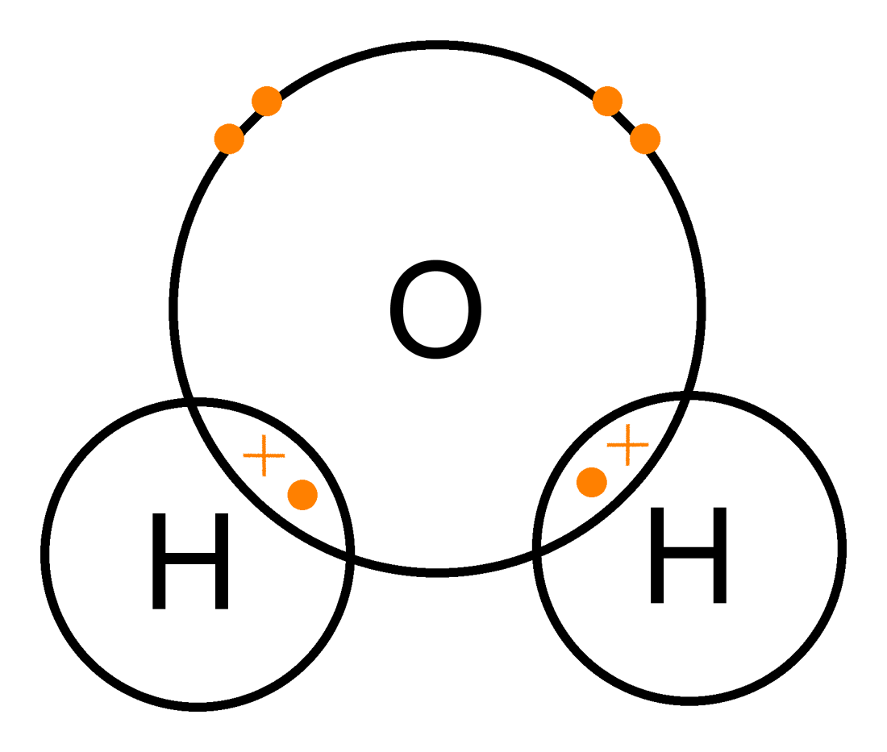

Slide 37
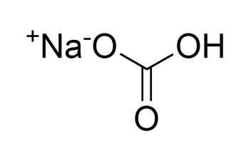
The chlorine atom also becomes ionized because it has gained an electron and now has more electrons than protons.
The two atoms are attracted to each other, resulting in an ionic bond because they have opposite electrostatic charges. Sodium, hydrogen, carbon, and oxygen atoms can combine to form a molecule of sodium bicarbonate (NaHCO3).
A measurable quantity of sodium bicarbonate constitutes a chemical compound commonly called baking soda.

Slide 38
Radioisotopes
Many factors affect nuclear stability.
Perhaps the most important is the number of neutrons.
When a nucleus contains too few or too many neutrons, the atom can disintegrate radioactively, bringing the number of neutrons and protons into a stable and proper ratio.
In addition to stable isotopes, many elements have radioactive isotopes or radioisotopes.
This may be artificially produced in machines such as particle accelerators or nuclear reactors.

Slide 39
Seven radioisotopes of barium have been discovered, all of which are artificially produced.
In the following list of barium isotopes, the radioisotopes are boldface: 127Ba, 128Ba, 129Ba, 130Ba, 131Ba, 132Ba, 133Ba, 134Ba, 135Ba, 136Ba, 137Ba, 138Ba, 139Ba, 140Ba
Artificially produced radioisotopes have been identified for nearly all elements.
A few elements have naturally occurring radioisotopes as well.

Slide 40
There are two primary sources of naturally occurring radioisotopes.
Some originated at the time of the Earth’s formation and are still decaying very slowly. An example is uranium, which ultimately decays to radium, which in turn decays to radon.
These and other decay products of uranium are radioactive.
Others, such as 14C, are continuously produced in the upper atmosphere through the action of cosmic radiation.
Radioisotopes can decay to stability in many ways, but two, beta emission and alpha emission, are important here for descriptive purposes.

Slide 41
Radioactive decay by positron emission is important for some nuclear medicine imaging.
During beta emission, an electron created in the nucleus is ejected from the nucleus with considerable kinetic energy and escapes from the atom.
The result is the loss of a small quantity of mass and one unit of negative electric charge from the nucleus of the atom.
Simultaneously, a neutron undergoes conversion to a proton.
The result of beta emission therefore is to increase the atomic number by one (Z → Z + 1), while the atomic mass number remains the same (A = constant).
This nuclear transformation results in the changing of an atom from one type of element to another.

Slide 42
Radioactive decay by alpha emission is a much more violent process.
The alpha particle consists of two protons and two neutrons bound together; its atomic mass number is 4.
A nucleus must be extremely unstable to emit an alpha particle, but when it does, it loses two.
The smallest particle of an element is an atom; the smallest particle of a compound is a molecule.
Matter has many levels of organization.
Atoms combine to make molecules and molecules combine to make tissues.

Slide 43
The interrelations between atoms, elements, molecules, and compounds are orderly.
This organizational scheme is what the ancient Greeks were trying to describe by their substances and essences.
RADIOACTIVITY
Some atoms exist in an abnormally excited state characterized by an unstable nucleus.
To reach stability, the nucleus spontaneously emits particles and energy and transforms itself into another atom.
This process is called radioactive disintegration or radioactive decay. The atoms involved are radionuclides.
Any nuclear arrangement is called a nuclide; only nuclei that undergo radioactive decay are radionuclides.

Slide 44
Radioactive Half-life
Radioisotopes disintegrate into stable isotopes of different elements at a decreasing rate so that the quantity of radioactive material never quite reaches zero.
Radioactive material is measured in becquerels and that 1 Bq is equal to disintegration of 1 atom each second.
The rate of radioactive decay and the quantity of material present at any given time are described mathematically by a formula known as the radioactive decay law.
From this formula, we obtain a quantity known as half-life (T1 2).
Half-lives of radioisotopes vary from less than a second to many years.

Slide 45
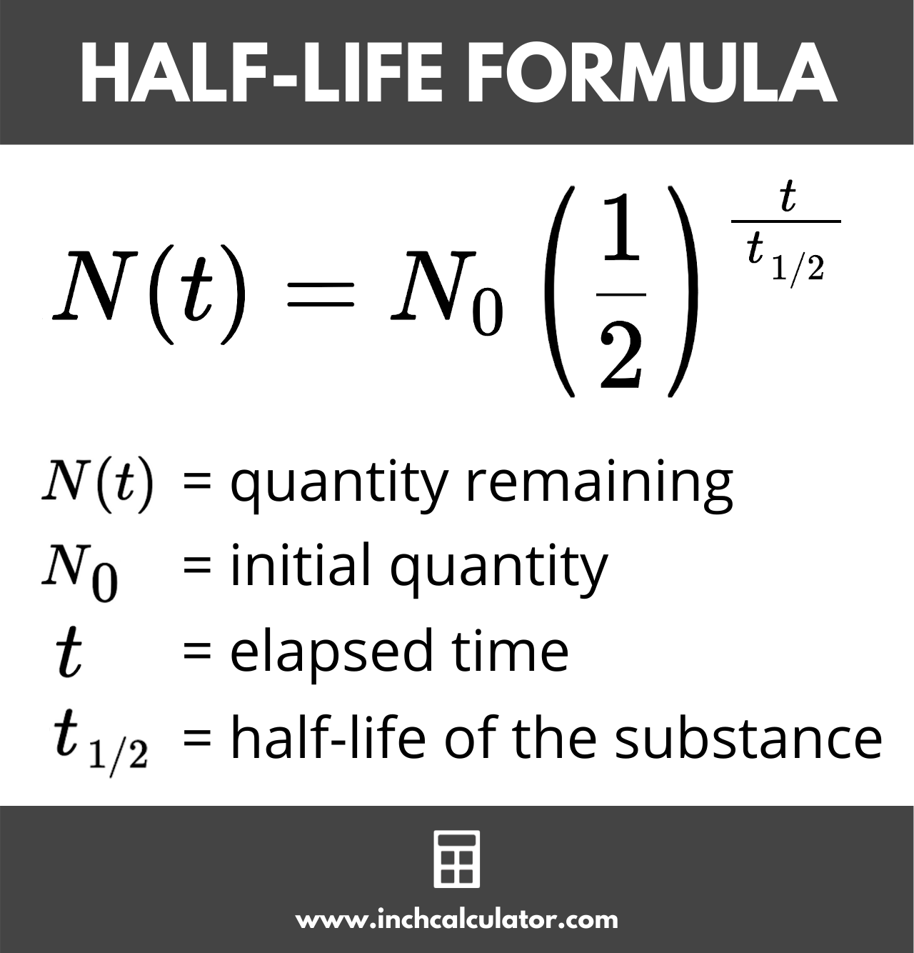
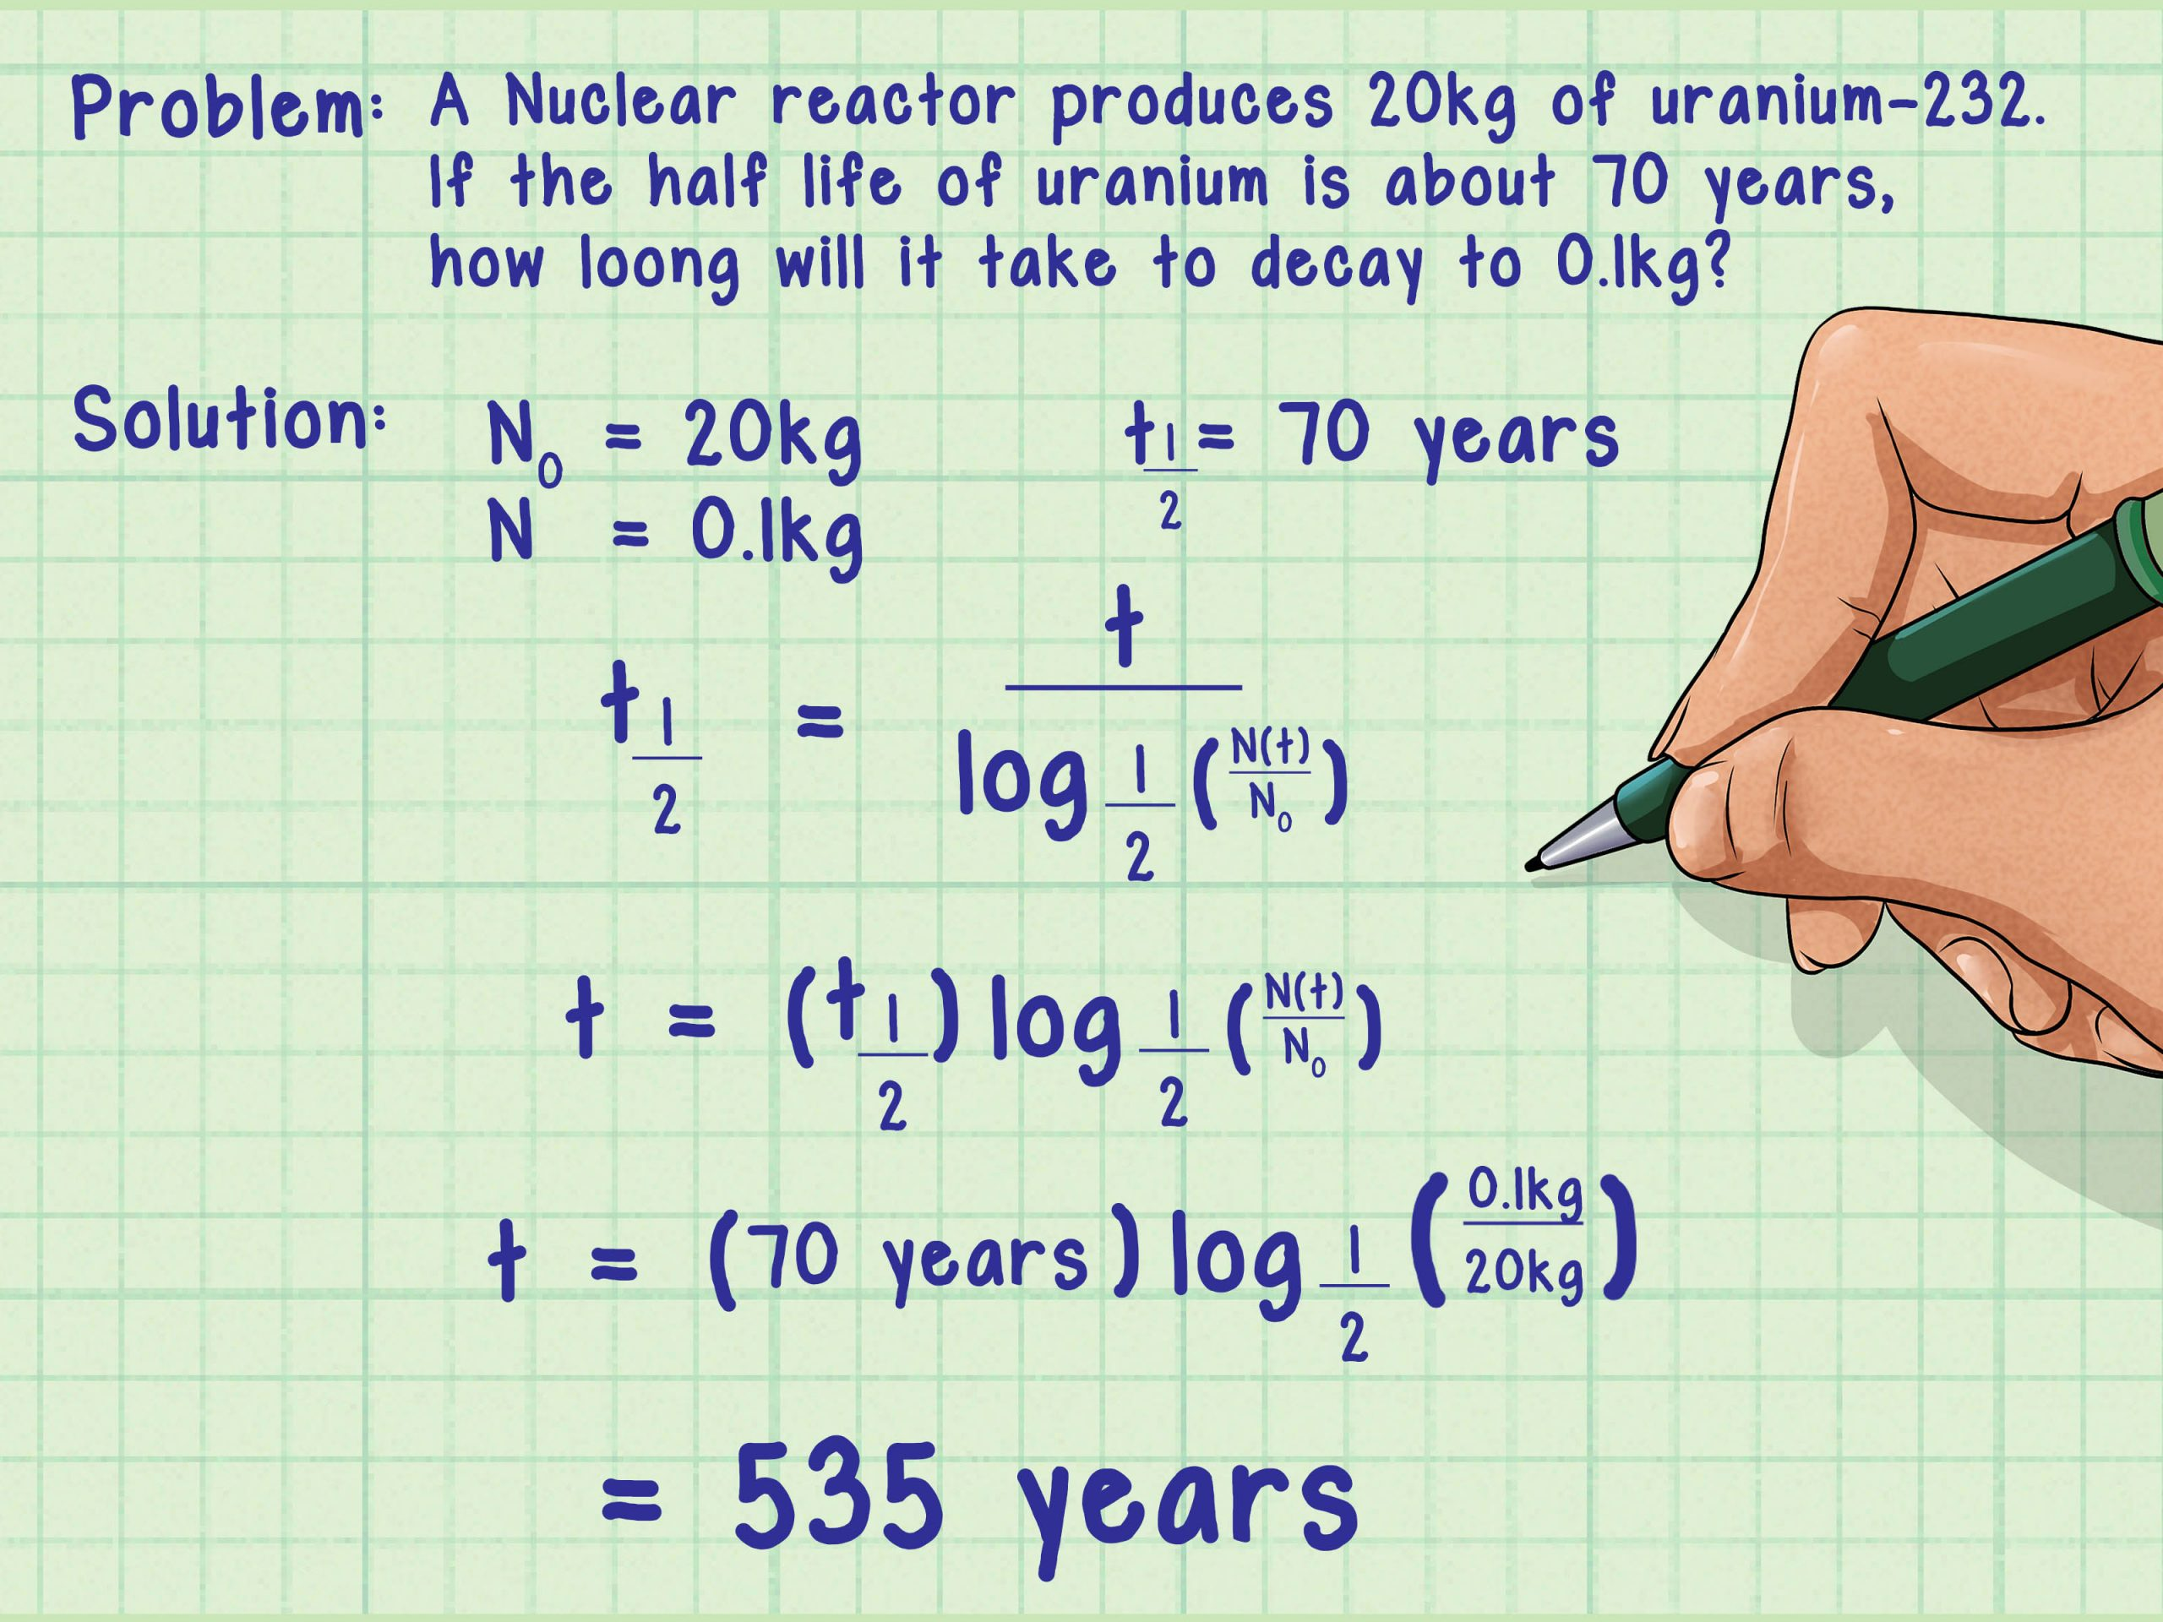

Slide 46
Each radioisotope has a unique, characteristic half-life.
The half-life of a radioisotope is the time required for a quantity of radioactivity to be reduced to one-half its original value.
The half-life of 131I is 8 days.
If 10 MBq of 131I was present on January 1 at noon, then at noon on January 9, only 5 MBq would remain.
On January 17, 2.5 MBq would remain, and on January 25, 1.25 MBq would remain.
A plot of the radioactive decay of 131I allows one to determine the amount of radioactivity remaining after any given length of time .
After approximately 24 days, or three half-lives, the linear-linear plot of the decay of 131I becomes very difficult to read and interpret.

Slide 47
The transformation is significant because the resulting atom is not only chemically different but is also lighter by 4 amu.
Radioactive decay results in emission of alpha particles, beta particles, and usually gamma rays.
Beta emission occurs much more frequently than alpha emission.
Virtually all radioisotopes are capable of transformation by beta emission, but only heavy radioisotopes are capable of alpha emission.
Some radioisotopes are pure beta emitters or pure alpha emitters, but most emit gamma rays simultaneously with the particle emission.

Slide 48
TYPES OF IONIZING
All ionizing radiation can be conveniently classified into two categories: particulate radiation and electromagnetic radiation .
The types of radiation used in diagnostic ultrasonography and in magnetic resonance imaging are nonionizing radiation.
Although all ionizing radiation acts on biologic tissue in the same manner, there are fundamental differences between various types of radiation.
These differences can be analyzed according to five physical characteristics: mass, energy, velocity, charge, and origin.
Particulate Radiation Many subatomic particles are capable of causing ionization.

Slide 49
Consequently, electrons, protons, and even rare nuclear fragments all can be classified as particulate ionizing radiation if they are in motion and possess sufficient kinetic energy.
At rest, they cannot cause ionization.
There are two main types of particulate radiation: alpha particles and beta particles.
Both are associated with radioactive decay.
The alpha particle is equivalent to a helium nucleus.
It contains two protons and two neutrons.
Its mass is approximately 4 amu, and it carries two units of positive electric charge.
Compared with an electron, the alpha particle is large and exerts great electrostatic force.

Slide 50
Alpha particles
Alpha particles are emitted only from the nuclei of heavy elements.
Light elements cannot emit alpha particles because they do not have enough excess mass (excess energy).
After being emitted from a radioactive atom, the alpha particle travels with high velocity through matter.
Because of its great mass and charge, however, it easily transfers this kinetic energy to orbital electrons of other atoms.
Ionization accompanies alpha radiation.
The average alpha particle possesses 4 to 7 MeV of kinetic energy and ionizes approximately 40,000 atoms for every centimeter of travel through air.
.

Slide 51
Because of this amount of ionization, the energy of an alpha particle is quickly lost.
It has a very short range in matter.
Whereas in air, alpha particles can travel approximately 5 cm; in soft tissue, the range may be less than 100 µm.
Consequently, alpha radiation from an external source is nearly harmless because the radiation energy is deposited in the superficial layers of the skin.
If an alpha-emitting radioisotope is deposited in the body, it can intensely irradiate the local tissue. Radon irradiating lung tissue is an important example

Slide 52
Beta Particles
Beta particles differ from alpha particles in terms of mass and charge.
They are light particles with an atomic mass number of 0 and carry one unit of negative or positive charge.
The only difference between electrons and negative beta particles is their origin.
Beta particles originate in the nuclei of radioactive atoms and electrons exist in shells outside the nuclei of all atoms. Positive beta particles are positrons.
They have the same mass as electrons and are considered to be antimatter.

Slide 53
Beta particle is an electron emitted from the nucleus of a radioactive atom.
After being emitted from a radioisotope, beta particles traverse air, ionizing several hundred atoms per centimeter.
The beta particle range is longer than that for the alpha particle.
Depending on its energy, a beta particle may traverse 10 to 100 cm of air and approximately 1 to 2 cm of soft tissue. Electromagnetic Radiation/Gamma Radiation
Electromagnetic Radiation X-rays and gamma rays are forms of electromagnetic ionizing radiation.
X-rays and gamma rays are often called photons.
Photons have no mass and no charge.

Slide 54
They travel at the speed of light (c = 3 × 108 m/s) and are considered energy disturbances in space.
Just as the only difference between beta particles and electrons is their origin, so the only difference between x-rays and gamma rays is their origin.
Gamma rays are emitted from the nucleus of a radioisotope and are usually associated with alpha or beta emission.
X-rays are produced outside the nucleus in the electron shells.
X-rays and gamma rays exist at the speed of light or not at all.

Slide 55
After being emitted, they have an ionization rate in air of approximately 100 ion pairs/cm, about equal to that for beta particles.
In contrast to beta particles, however, x-rays and gamma rays have an unlimited range in matter.
Photon radiation loses intensity with distance but theoretically never reaches zero.
Particulate radiation, on the other hand, has a finite range in matter, and that range depends on the particle’s energy.
In nuclear medicine, beta and gamma radiation are most important.
In radiography, only x-rays are important.

